Slide 1
Characterization of Nonlinear Neuron Responses
Matt Whiteway
whit8022@umd.edu
Dr. Daniel A. Butts
dab@umd.edu
Neuroscience and Cognitive Science (NACS)
Applied Mathematics and Scientific Computation (AMSC)
Biological Sciences Graduate Program (BISI)
AMSC 664 Final Presentation

Slide 2
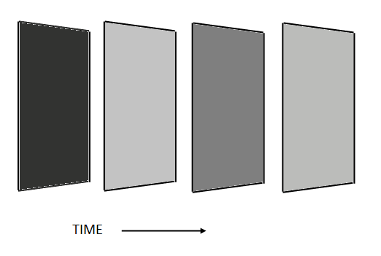
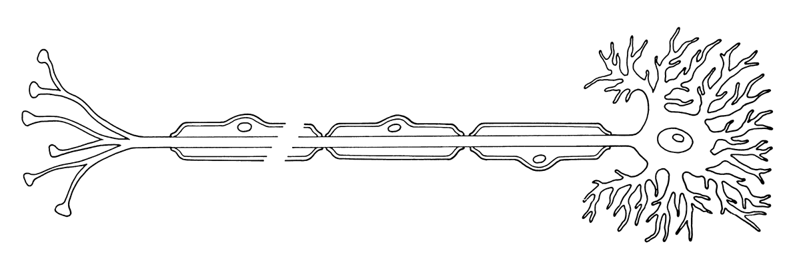
The Question
Introduction MLEs NIM Testing Conclusion
What is the functional relationship between a neuron’s stimulus and response?
STIMULUS
RESPONSE

Slide 3
The Question
Introduction MLEs NIM Testing Conclusion
What is the functional relationship between a neuron’s stimulus and response?
Divide up total interval into discrete time bins
How do we model ?

Slide 4
The Models
Introduction MLEs NIM Testing Conclusion
Moment-based estimators
Spike Triggered Average (STA)
Spike Triggered Covariance (STC)
Maximum Likelihood estimators
Generalized Linear Model (GLM)
Generalized Quadratic Model (GQM)
Nonlinear Input Model (NIM)

Slide 5
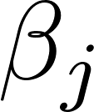
Maximum Likelihood Estimators
Introduction MLEs NIM Testing Conclusion
We can use parametric models, and take into account
Background firing rate
Stimulus covariates
History covariates
Generalized Linear Model
is a constant
is the stimulus and are the stimulus coefficients
is the spike history and are the history coefficients

Slide 6
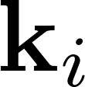
Maximum Likelihood Estimators
Introduction MLEs NIM Testing Conclusion
Generalized Linear Model
Generalized Quadratic Model
Nonlinear Input Model
is a constant
is the stimulus and are the stimulus coefficients
is the spike history and are the history coefficients

Slide 7
Maximum Likelihood Estimators
Introduction MLEs NIM Testing Conclusion
For the likelihood function we assume the spiking probabilities for each bin are independent
Taking logs,
To include regularization,

Slide 8
Maximum Likelihood Estimators
Introduction MLEs NIM Testing Conclusion
MLEs are the set of parameters that maximize this function
If F(u) is convex in u and log(F(u)) is concave in u, then there will only be a single global maximum (Paninski 2004)
Used MATLAB’s fminunc routine (faster than my own)
GLM has a single global maximum
GQM in practice has 2 maxima
NIM can have more, though in practice usually find 1

Slide 9
Nonlinear Input Model
Introduction MLEs NIM Testing Conclusion
Focus on NIM
Take to be rectified linear functions
Constrain
is a constant
is the stimulus and are the stimulus coefficients
is the spike history and are the history coefficients

Slide 10
Model Selection
Introduction MLEs NIM Testing Conclusion
How to choose N₊ and N_?
Akaike’s Information Criterion (s is length of filter)
Bayesian Information Criterion (n is size of data set)

Slide 11
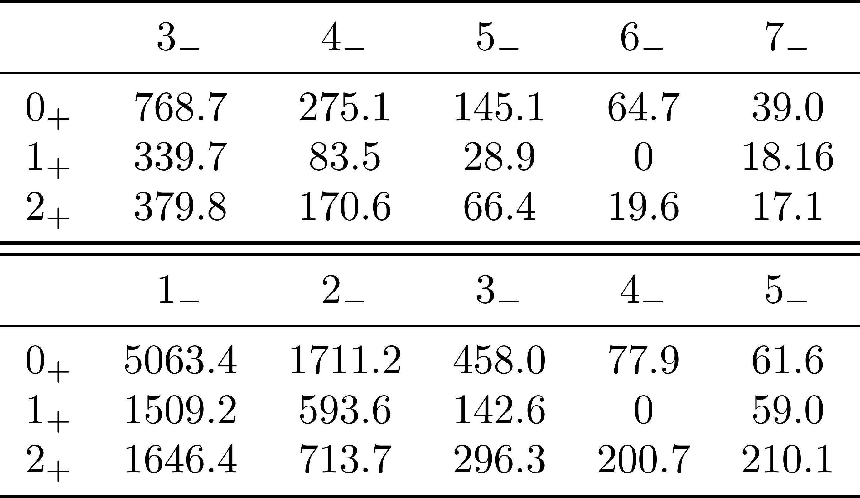
Model Selection
Introduction MLEs NIM Testing Conclusion
AIC
BIC

Slide 12
Model Validation
Introduction MLEs NIM Testing Conclusion
MLEs are consistent – with large enough sample size, MLE will be arbitrarily close to true parameters ( )
Synthetically create data with pre-made filters, and estimate these filters using different sample sizes
MSE between estimates and original filters should go to zero

Slide 13
Model Validation
Introduction MLEs NIM Testing Conclusion
Inhibitory Filter
History Dependence
Results for 10000 time bins (about 1800 spikes)

Slide 14
Model Validation
Introduction MLEs NIM Testing Conclusion

Slide 15
Model Testing
Introduction MLEs NIM Testing Conclusion
Relative Log-likelihood per spike
0 for the model that predicts the average firing rate
Can be as large as the single-spike information
Higher values indicate the model is preserving more of the information that is present in the actual spike (on average)

Slide 16
Model Testing
Introduction MLEs NIM Testing Conclusion
STA STC GLM GQM NIM NIMh
STA STC GLM GQM NIM NIMh
Upsampling Factor of 1
Upsampling Factor of 2

Slide 17
Model Testing
Introduction MLEs NIM Testing Conclusion
Fraction of Variance Explained
If model predicts average firing rate, FVE = 0
If model predicts exact firing rate, FVE = 1

Slide 18
Model Testing
Introduction MLEs NIM Testing Conclusion
Where does r^{obs} come from?

Slide 19
Model Testing
Introduction MLEs NIM Testing Conclusion

Slide 20
Model Testing
Introduction MLEs NIM Testing Conclusion
Model is able to explain more of the variation for large time bins

Slide 21
Schedule
Introduction MLEs NIM Testing Conclusion
PHASE I (October-December)
Implement and validate STA (October)
Implement and validate GLM with regularization (November-December)
Complete mid-year progress report and presentation (December)

Slide 22
Schedule
Introduction MLEs NIM Testing Conclusion
PHASE II (January-May)
Implement quasi-Newton method for gradient descent (January)
Implement and validate STC (January-February)
Implement and validate GQM with regularization (February)
Implement and validate NIM with regularization using rectified linear upstream functions (March)
Test all models (April)
Complete final report and presentation (April-May)

Slide 23
Schedule
Introduction MLEs NIM Testing Conclusion
PHASE III (Other features to consider)
Adding history component
Representing the filters using basis functions
Representing the nonlinearities of the NIM using basis functions (more difficult – optimization has to be modified)
Networks…?

Slide 24
Deliverables
Introduction MLEs NIM Testing Conclusion
All presentations
All reports
Commented code for all models, model validation and model testing
Dataset used for validation and testing, mat files that contain results of testing

Slide 25
References
Introduction MLEs NIM Testing Conclusion
Chichilnisky, E.J. (2001) A simple white noise analysis of neuronal light responses. Network: Comput. Neural Syst., 12, 199-213.
Schwartz, O., Chichilnisky, E. J., & Simoncelli, E. P. (2002). Characterizing neural gain control using spike-triggered covariance. Advances in neural information processing systems, 1, 269-276.
Paninski, L. (2004) Maximum Likelihood estimation of cascade point-process neural encoding models. Network: Comput. Neural Syst. ,15, 243-262.
Schwartz, O. et al. (2006) Spike-triggered neural characterization. Journal of Vision, 6, 484-507.
Paninski, L., Pillow, J., and Lewi, J. (2006) Statistical models for neural encoding, decoding, and optimal stimulus design.
Park, I., and Pillow, J. (2011) Bayesian Spike-Triggered Covariance Analysis. Adv. Neural Information Processing Systems ,24, 1692-1700.
Butts, D. A., Weng, C., Jin, J., Alonso, J. M., & Paninski, L. (2011). Temporal precision in the visual pathway through the interplay of excitation and stimulus-driven suppression. The Journal of Neuroscience, 31(31), 11313-11327.
McFarland, J.M., Cui, Y., and Butts, D.A. (2013) Inferring nonlinear neuronal computation based on physiologically plausible inputs. PLoS Computational Biology.

